Slide 1
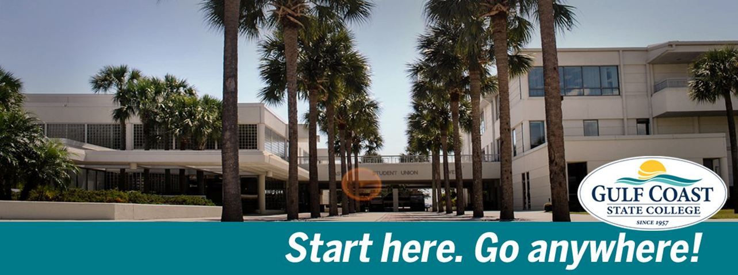
How to pay for college
Ursula Backus / Kris Hatcher, GCSC Financial Aid

Slide 2
Quality
What is it?
How to apply?
Notes:
Agenda
What is financial aid and where can it come from?
How to apply for financial aid?

Slide 3
Quality
What is financial aid?
Notes:
Financial aid = Any / all types of financial assistance a student receives to help pay for college!

Slide 4
Quality
Types of financial aid
Gift aid
Self-help aid
Notes:
Gift Aid = Financial assistance that a student does not typically have to repay
Federal Grants - https://studentaid.ed.gov/sa/types/grants-scholarships
Florida Grants - http://www.floridastudentfinancialaid.org/SSFAD/home/uamain.htm
Self-Help Aid = Student takes responsibility for receiving work study or loans
Work Study – Part time employment for students attending at least half-time, paid at least the federal minimum wage
Federal - https://studentaid.ed.gov/sa/types/work-study
State - http://www.floridastudentfinancialaid.org/SSFAD/factsheets/FWEP.pdf
Federal Loans – Money students can borrow to help finance their post-secondary education
https://studentaid.ed.gov/sa/types/loans/subsidized-unsubsidized
Subsidized = 4.29% interest rate
Unsubsidized = 4.29% interest rate
PLUS (Parent) Loans = 6.84% interest rate
Repayment of federal student loans begins six months after the student drops to less-than-half-time enrollment (<6.0 C/Hs) or graduates
There are seven different repayment plans -https://studentaid.ed.gov/sa/repay-loans/understand/plans
Non-Income-Based
Standard
Graduated
Extended
Income-based
Income-Based
Pay-As-You-Earn
Income-Contingent
Income-Sensitive
Avoid ‘Private’ / ‘Alternative’ loans at all costs

Slide 5
Quality
Categories of financial aid
Need-based aid
Merit-based aid
Talent-based aid
Non need-based aid
Notes:
Need-Based Aid ( typically associated with the word “Grant” )
Based upon how much “need” a family has for financial assistance
Merit-Based Aid ( typically associated with the word “Scholarship” )
Based upon a student’s academic performance, e.g. Bright Futures
Talent-Based Aid
Based upon a student’s athletic, musical or artistic ability
Non-Need-Based Aid
Everything else, e.g. Unsubsidized loan & Teach Grant

Slide 6
Quality
Sources of financial aid
Federal government
State government
Colleges & Universities
Private entities
Notes:
Federal = U.S. Department of Education (ED)
State = Florida Office of Student Financial Assistance (OSFA)
Institutions = Gulf Coast State College (GCSC), Florida State University (FSU), etc.
Private = Bay Education Foundation (BEF)

Slide 7
Quality
How to apply for financial aid?

Slide 8
Quality
Federal financial aid
Free Application for Federal Student Aid (FAFSA)
fsaid.ed.gov & www.fafsa.gov
Must re-apply every year!
Requires parental, income, household info, etc.
Notes:
To apply for federal financial aid:
Obtain your Federal Student Aid (FSA) ID at fsaid.ed.gov
Obtain your parent’s FSA ID at fsaid.ed.gov too (only one parent needs a FSA ID)
Submit a FAFSA at www.fafsa.gov

Slide 9
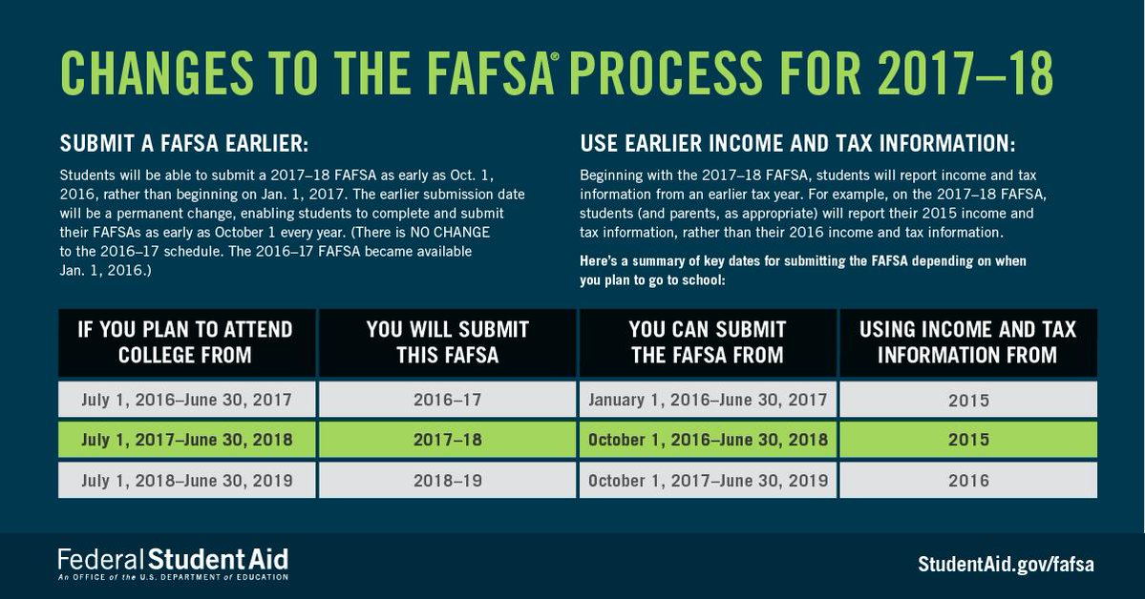
Quality
Notes:
Gather you and your parent’s federal tax return information:
2016-2017 FAFSA = 2015 taxes
2017-2018 FAFSA = 2015 taxes (yes, 2015 again)
Complete / submit a FAFSA to all the schools you plan on applying to by visiting www.fafsa.gov
2016-2017 FAFSA ( fall 2016, spring 2016 & summer 2017 ) is available 01/01/2016 – 06/30/2017
2017-2018 FAFSA ( fall 2017, spring 2017 & summer 2018 ) is available 10/01/2016 – 06/30/2018
Contact the financial aid office at the school you plan on attending to see if there is any follow up to complete

Slide 10
Quality
Notes:
Cost of Attendance = How much one year (typically the nine months comprising a student’s fall & spring semesters) costs –
Direct costs, charges you pay directly to a school:
Tuition & Fees
Books & Supplies
Indirect costs, charges you do not pay directly to a school but might incur generally:
Room & Board (food)
Travel expenses
Miscellaneous expenses
Expected Family Contribution = Score of a student’s FAFSA, i.e. how much “need” does a student have for financial assistance

Slide 11
Quality
State financial aid
Florida Financial Aid Application
Opens October 1st and you must complete it before finishing high school
www.FloridaStudentFinancialAid.org
www.FloridaShines.org
Notes:
Apply for the following state financial aid program by visiting http://www.floridastudentfinancialaid.org/SSFAD/home/uamain.htm
Florida Student Assistance Grant (FSAG)
First Generation Matching Grant (FGMG)
Bright Futures (BF)
Many more!
• The “Florida Financial Aid Application” (FFAA) opens October 1st of a student’s senior year
• Students should submit a FFAA even if they don’t initially plan on attending a Florida institution, just in case they transfer back their sophomore year

Slide 12
Quality
State financial aid
BF Academic Scholars (FAS) & Medallion (FMS)
Notes:
High School GPA Evaluation for Bright Futures includes an unrounded weighted high school GPA (calculated to two decimal places) in the 16 college-preparatory credits. The following courses are weighted .25 per semester course or .50 per year course in the calculation of the GPA: Advanced Placement (AP), Pre-International Baccalaureate (Pre-IB), International Baccalaureate (IB), Honors, PreAdvanced International Certificate of Education (Pre-AICE), Advanced International Certificate of Education (AICE) or academic Dual Enrollment. For example, whereas an ‘A’ equals 4 quality points for an un-weighted course, an ‘A’ would equal 4.5 quality points for a weighted course. If necessary, students may use two additional credits from courses in the above academic areas, or from AP, IB, or AICE fine arts courses to raise their GPA.
College Entrance Exams The College Board introduced a new entrance exam (Redesigned SAT®) beginning March 2016.
The SAT® (SAT administered prior to March 2016) combined score is the sum of the best Critical Reading and Math scores from any test sitting of this version of the ‘Old’ SAT®.
The Redesigned SAT® (SAT administered beginning March 2016) combined score is the sum or the best Evidence-based Reading and Writing and Math from any test sitting of this version of the ‘New’ SAT®.
The ACT® composite score is the average of the best scores across the four subject area sections from any test sitting: English, Math, Reading and Science. Composite scores ending in 0.50 will be rounded up to the next whole number.
The ACT®/SAT® exams may be taken an unlimited number of times through June 30 of the student’s graduation year (or through January 31 for mid-year graduates).
Request test scores be sent to one of Florida’s 12 state universities, Florida state colleges (public community colleges), or public high schools when registering for the ACT®/SAT® so that test scores will be sent to the Florida Department of Education (FDOE) repository.
Service Hours
Students must complete volunteer service hours during high school and by high school graduation. Service hours may include, but are not limited to, a business or governmental internship, work for a nonprofit community service organization, or activities on behalf of a candidate for public office. The hours must be documented in writing, and signed by the student, the student's parent or guardian, and a representative of the organization. Each public school district and private school establishes approved activities and the process for documentation of service hours.
IB Curriculum
Complete a minimum of 10 credits identified by the International Baccalaureate Organization: o Two credits each in three of the following areas and one credit each in the remaining three areas: Language Arts, World Language, Social Studies, Science, Mathematics and Arts/Electives. (Each of these credits must be an IB or AP course. Pre-IB courses do not meet IB curriculum requirements.) o One credit in Theory of Knowledge
Complete the Creativity, Action, Service (CAS) requirement
Complete an extended essay

Slide 13
Quality
State financial aid
BF Florida Gold Seal Vocational Scholars (GSV)
Notes:
The Florida Gold Seal Vocational Scholars (GSV) can only be used to fund a career education or certificate program, i.e. not available for Associate of Arts degrees. Florida high school students who wish to qualify for the Florida Gold Seal Vocational Scholars (GSV) award must meet the following initial eligibility requirements: • Graduate from high school with a Standard Diploma (high school graduation requirements); • Achieve the required weighted minimum 3.0 GPA in the non-elective high school courses; • Take at least 3 full credits in a single Career and Technical Education program; • Achieve the required minimum 3.5 unweighted GPA in the career education courses; • Achieve the required minimum score on the ACT®, SAT®, or Florida Postsecondary Education Readiness Test (P.E.R.T.) exams • Complete 30 service hours. College Entrance Exams Exam types cannot be combined; a student must qualify based on each sub-test score for a single exam type. Sub-test scores from different test dates may be used to meet the test requirement. Scores taken through June 30 of the student's senior year (for a regular graduate, or January 31 for a mid-year graduate) will be accepted for Bright Futures evaluation. There is no limit to the number of times a student may retake the test prior to June 30 of the student’s graduation year. Request test scores be sent to one of Florida’s 12 state universities, Florida state colleges (public community colleges), or public high schools when the student registers for the ACT®/SAT® so that test scores will be sent to the FDOE repository.
Service Hours Students must complete volunteer service hours during high school and by high school graduation. Service hours may include, but are not limited to, a business or governmental internship, work for a nonprofit community service organization, or activities on behalf of a candidate for public office. The hours must be documented in writing, and signed by the student, the student's parent or guardian, and a representative of the organization. Each public school district and private school establishes approved activities and the process for documentation of service hours.

Slide 14
Quality
State financial aid
BF Florida Gold Seal CAPE Scholars (GSC)
Used to fund a career education or a certificate program
Meet general Bright Futures requirements
Earn a minimum of 5 postsecondary credit hours through CAPE industry certifications which articulate college credit
Complete 30 service hours
Notes:
The Florida Gold Seal CAPE Scholars award (GSC) can only be used to fund a career education or certificate program. Upon completion of an associate in science degree program that articulates to a bachelor of science degree, a GSC Scholar may also receive an award for a maximum of 60 credit hours toward a bachelor of science degree program. Upon completion of an associate in applied science program, a GSC Scholar may also receive an award for a maximum of 60 credit hours toward a bachelor of applied science degree program. Florida high school students who wish to qualify for the Florida Gold Seal CAPE Scholars award must meet the following initial eligibility requirements:
Meet the General Requirements for Bright Futures;
Earn a minimum of 5 postsecondary credit hours through CAPE industry certifications which articulate for college credit; and
Complete 30 service hours. Service Hours Students must complete volunteer service hours during high school and by high school graduation. Service hours may include, but are not limited to, a business or governmental internship, work for a nonprofit community service organization, or activities on behalf of a candidate for public office. The hours must be documented in writing, and signed by the student, the student's parent or guardian, and a representative of the organization. Each public school district and private school establishes approved activities and the process for documentation of service hours.

Slide 15
Quality
State financial aid
BF Renewal criteria:
Notes:
Bright Futures Renewal A student who receives funding during the current academic year (fall through spring) is automatically evaluated for renewal at the end of the spring term and does not submit a renewal application. The student’s institution sends the Office of Student Financial Assistance (OSFA) each student’s GPA and hours earned. Eligibility notifications are then posted to each student’s online Financial Aid Recipient History (FARH). A spring/summer cohort student at the University of Florida who receives funding during the current academic year (spring and summer) is evaluated for renewal at the end of the summer term. 2009-10 and later high school graduates: Students who do not meet the annual minimum renewal GPA requirement in their first year of funding will be permitted a one-time restoration in a subsequent summer or academic year renewal period (end of spring term). Students who do not meet the minimum earned hours requirement or who fail to meet the minimum GPA requirement after their first year of funding will NOT be permitted a restoration opportunity.
Grade Point Average (GPA) Requirement
See table.
Credit Hour Requirement A student who receives funding during the current academic year (fall through spring) is automatically evaluated for renewal at the end of the spring term. The annual credit hour renewal requirement for the Bright Futures Scholarship Program is the measure of the number of credit hours a student must earn based on the student’s enrollment type per term. The enrollment type of a student is based on credit hours funded after the institution’s Drop/Add period.

Slide 16
Quality
Institutional financial aid
Foundations
Non-profits designed to provide scholarship opportunities for deserving students
www.gcccfoundation.org
Notes:
Foundation = Financial assistance given to a student by an institution’s “Foundation”, which seeks to raise money from a community for scholarships & grants.
Students must apply for GCSC Foundation scholarships & grants January 1st to April 15th
There are four types of Foundation opportunities available at GCSC:
General Foundation Scholarships
Endowed Foundation Scholarships
High School Honors Scholarships
Minority Related Scholarships

Slide 17
Quality
Private financial aid
Variety of sources
Don’t pay for an online scholarship website!
Need-based grants probably require FAFSA
www.fastweb.com
Notes:
Private financial aid = Financial assistance given to you by a private company, organization or individual
Don’t pay for any online scholarship websites that charge fees!
www.fastweb.com is a free online scholarship website
Awards may be need-based so filing FAFSA is a must
Notify your financial aid office if you are awarded a private scholarship

Slide 18
Quality
Financial aid tools
College Scorecard https://collegescorecard.ed.gov
Net Price Calculators
Financial Aid Shopping Sheets

Slide 19
Quality
Financial aid websites
www.StudentAid.gov
www.facebook.com/FederalStudentAid
www.twitter.com/FAFSA
www.youtube.com/FederalStudentAid

Slide 20
Quality
Questions?

